Slide 1
CST2335 Graphical Interface programming
Extra material
Wear and TV applications

Slide 2
Introduction
Android wear applications are just like normal applications except they are on a watch.
You must create two special directories for the layouts on round and square watches:
layout-round and layout-notround
Have a look at github branch: week2_Watch
To change an android application to a watch application, add this to AndroidManifest.xml:
<uses-feature android:name="android.hardware.type.watch"/>

Slide 3
Small screen space
You will also see the toolbar in the watch application. This takes a lot of screen space, so change your application’s style to inherit from a style that has NoActionBar. In values/styles.xml, change:
<style name="AppTheme" parent="Theme.AppCompat.NoActionBar">
You should not use an EditText for the user to type in text. The screen is just too small. The watch interface should just be for text, small images, buttons, or switch/checkbox.
Add this line in the file AndroidManifest.xml for watches:
<uses-feature android:name="android.hardware.type.watch"/>

Slide 4
Square, Round and Chin interfaces
A round interface extends past the radius of the circle:
More info:
https://developer.android.com/training/wearables/ui/layouts
Square
Circle
Chin

Slide 5
Circle
In order for the widgets to appear in the middle of the screen, set the layout_gravity=“center”.
The first element should have
layout_marginTop=“30dp” to push it down
from the top of the watch
Look at activity_main_linear in layout-round folder
Circle

Slide 6
ScrollView
If you put a ScrollView around a LinearLayout, it will make the LinearLayout scrollable off screen.
Look at activity_main_linear in layout-notround folder
Square

Slide 7
Just add ScrollView
<ScrollView xmlns:android="http://schemas.android.com/apk/res/android" xmlns:app="http://schemas.android.com/apk/res-auto" android:layout_height="match_parent" android:layout_width="match_parent">
<LinearLayout android:orientation=“vertical">
</LinearLayout>
</ScrollView>

Slide 8
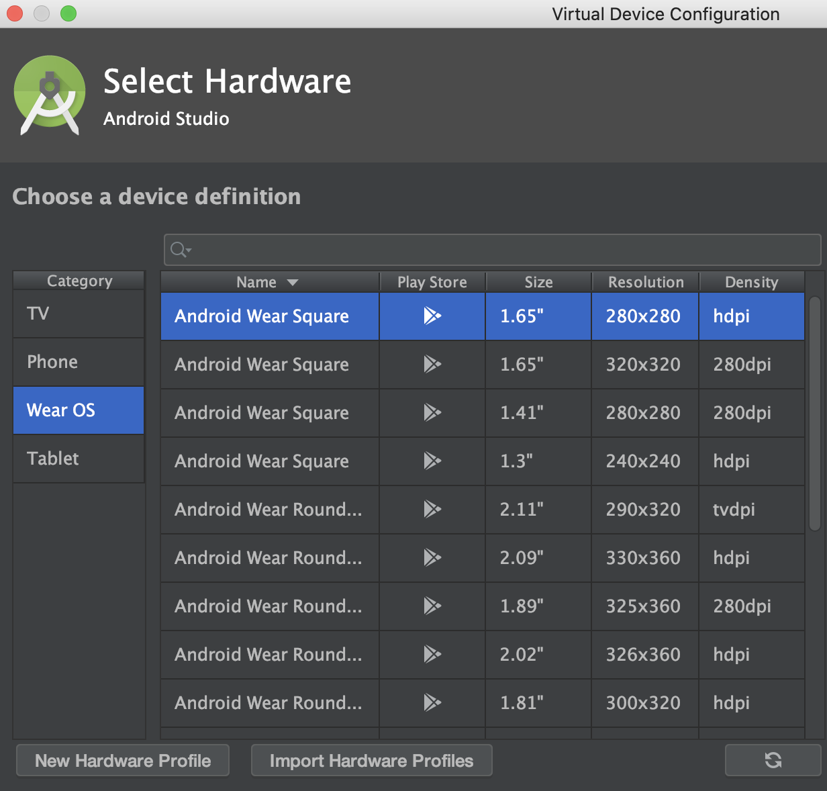
Create watch virtual device
Create both a square and circle face watch:
If you run the example on a phone or
Tablet, you should see the normal weather
application.
You can’t run this application on a watch
emulator because it’s missing this line in
the manifest:
<uses-feature android:name="android.hardware.type.watch"/>

Slide 9
Summary
Take a normal Android application but create special watch layouts in layout-round and layout-notround directory.
Add this line in the manifest for watches:
<uses-feature android:name="android.hardware.type.watch"/>
Add a <ScrollView> around a <LinearLayout> to make it scrollable.
Set the layout_gravity=“center” so that Widgets are in the middle
Add a marginTop to the LinearLayout so that the first element is not cut off
Don’t use EditText on a watch face.

Slide 10
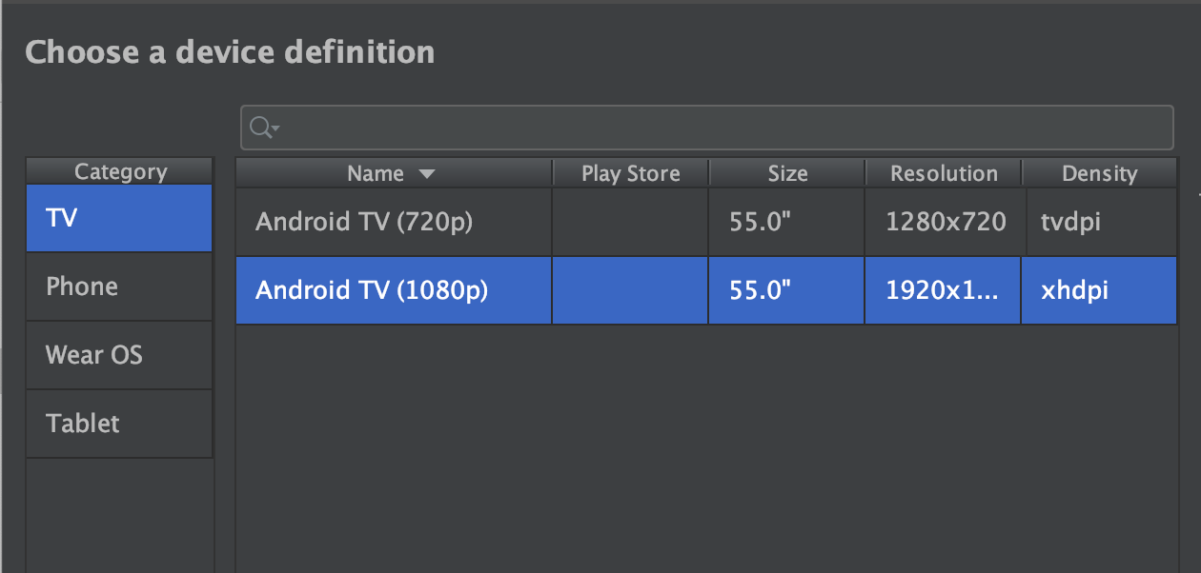
TV Application
TV applications are the same as normal applications only with a fixed screen ratio (1920x1080). 4K tv is 3840x2160.
TV applications are mainly for navigating videos. The interfaces are really basic since there is no keyboard. The only input is the direction pad (D-pad).
Look at the branch week2_TV on github.
Create a TV virtual device:

Slide 11
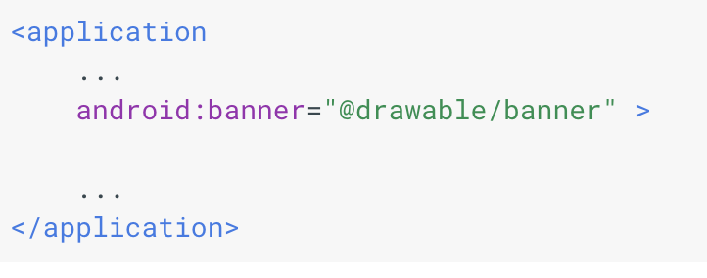
TV Application
In the AndroidManifest,xml, specify that the TV doesn’t have touch input:
<uses-feature android:name="android.hardware.touchscreen" android:required="false" />
<uses-feature android:name="android.software.leanback" android:required="true"/>
Provide a homescreen banner:
This banner can be localized
using the proper drawable folder

Slide 12
Android TV application
Some TVs cut off part of the video to scale the image properly. In your layout files, you should add a buffer zone around the edge of the screen:
android:layout_marginTop="27dp"
android:layout_marginBottom="27dp"
android:layout_marginLeft="48dp"
android:layout_marginRight="48dp"

Slide 13
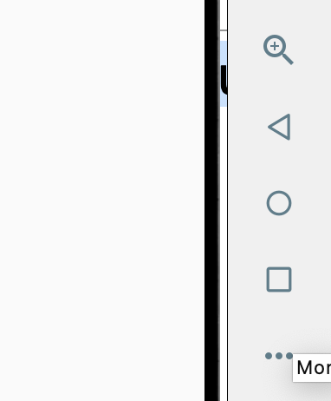



Android TV application
In the layout, add buttons, listViews. You should handle d-pad navigation: up, down, left, right.
android:nextFocusDown="@id/item1"
android:nextFocusUp="@id/item2"
android:nextFocusRight="@id/item3"
android:nextFocusLeft="@id/item4”
The D-pad is accessible through
the more button on the emulator:

Slide 14
Video player
A VideoView is a widget that plays videos. In a layout, add <VideoView> in the XML. In Java:
VideoView player =(VideoView) findViewById(R.id.videoView);
mediaController = new MediaController(this);
mediaController.setAnchorView(player);
mediaController.setMediaPlayer(player);
player.setMediaController(mediaController);
player.setVideoURI(Uri.parse("https://archive.org/download/ElephantsDream/ed_1024_512kb.mp4"));
player.setOnPreparedListener( video ->{
player.seekTo(position);
if(position == 0). player.start();
});

Slide 15
Video player
Remember to enable internet permissions to the AndroidManifest.xml
Here are some other videos you can try playing for free. They are student’s animation projects from school:
http://ftp.halifax.rwth-aachen.de/blender/demo/movies/ToS/tears_of_steel_720p.mov
http://peach.themazzone.com/durian/movies/sintel-1280-surround.mp4
https://archive.org/download/ElephantsDream/ed_1024_512kb.mp4

Slide 16
Summary
Take your Android application and put an empty margin around the edge of the screen (slide 10, lines 8-11 in ActivityMain.xml)
Add a line to AndroidManifest.xml saying that the device doesn’t require a touch screen, and needs the Leanback libraries (TV fonts & colours) (slide 9, lines 5 & 6 in AndroidManifest.xml)
For each element in your GUI, say what the next element will be if you click the D-Pad Up, Down, Left & Right. (slide 11, lines 18&19 in ActivityMain.xml

